Slide 1
Control Flow Graph
& Execution Analysis
Group 12

Slide 2
Original Idea
User uploads Java file
Statically generate and visualize control flow graph

Slide 3
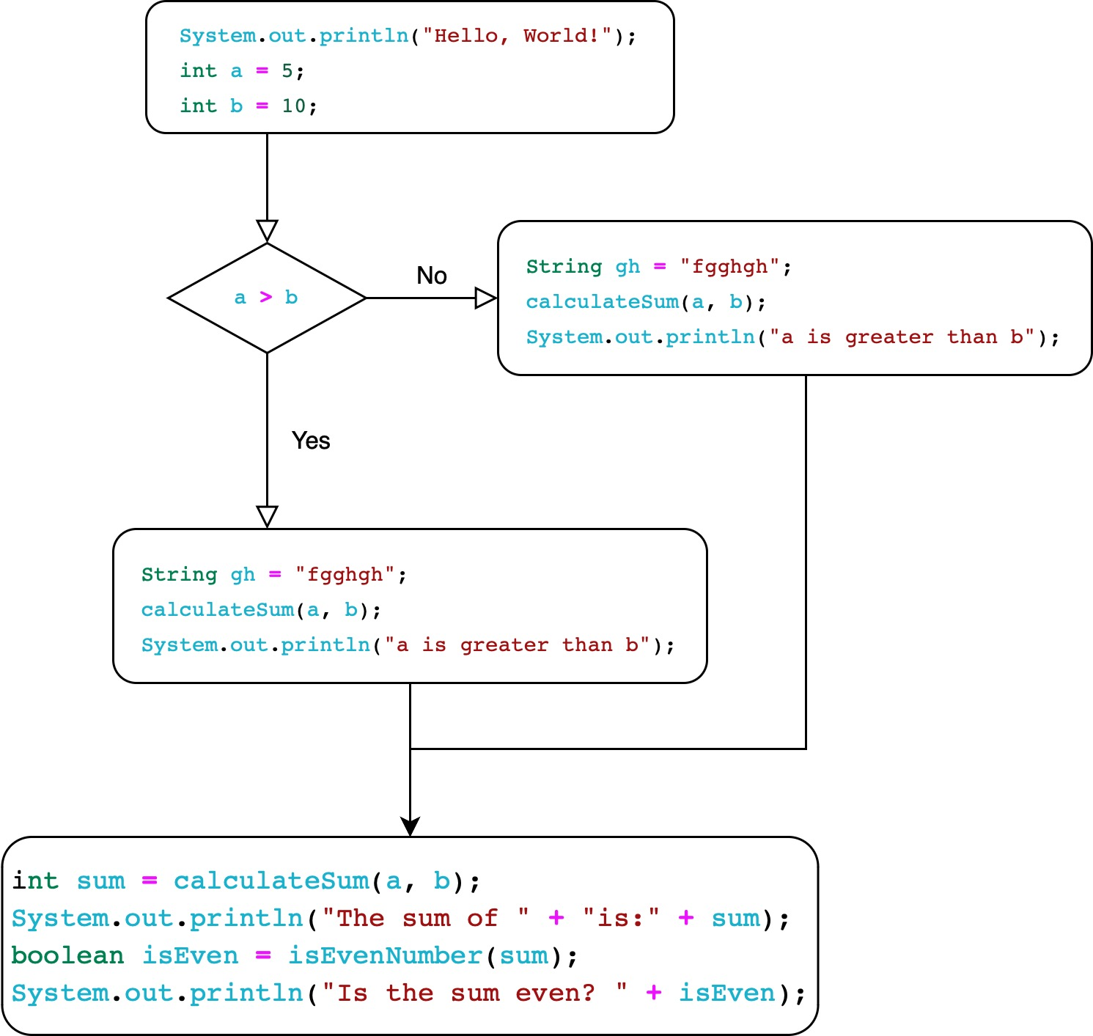
Generate CFG (Control Flow Graph)
public static void main(String[] args) {
System.out.println("Hello, World!");
int a = 5;
int b = 10;
if (a > b) {
String gh = "fgghgh";
calculateSum(a, b);
System.out.println("a is greater than b");
} else {
isEvenNumber(a);
System.out.println("b is greater than a");
}
int sum = calculateSum(a, b);
System.out.println("The sum of "+ a + "and" + b + "is:" + sum);
boolean isEven = isEvenNumber(sum);
System.out.println("Is the sum even? " + isEven);
}
public static int calculateSum(int num1, int num2) { // ... Code}
public static void nestedFunction() { // ... Code}
public static boolean isEvenNumber(int num) { // ... Code}
More Analysis Needed…

Slide 4
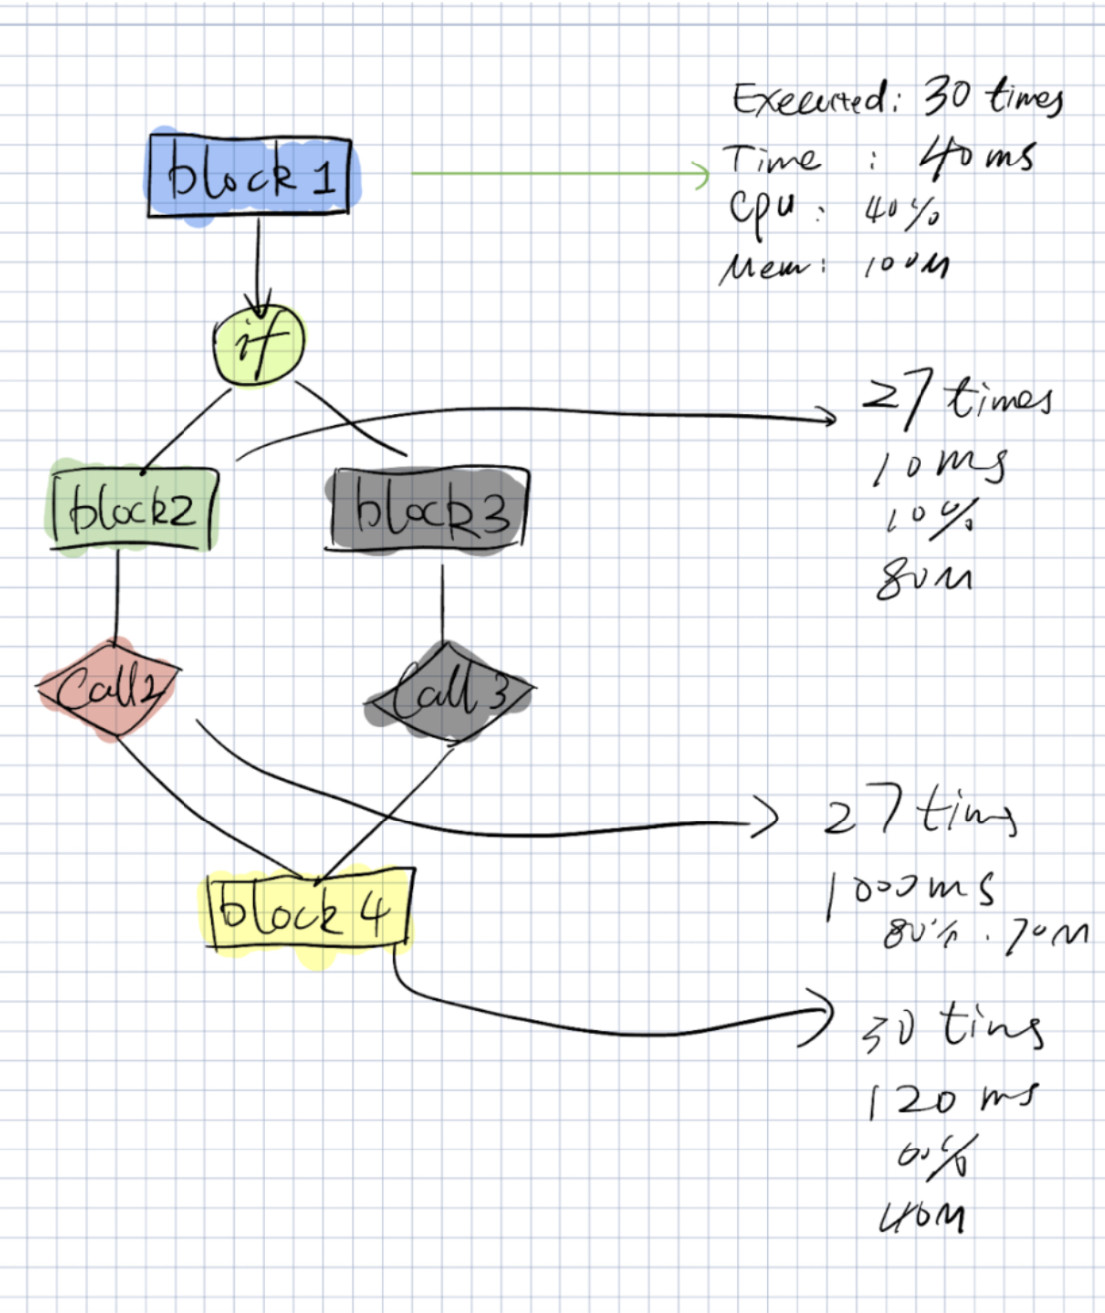
Final Idea
User uploads file
CFG is visualized
Run the file
Dynamic runtime information added to CFG

Slide 5
Instrumentation
public static void main(String[] args) {
System.out.println("Hello, World!");
int a = 5;
int b = 10;
if (a > b) {
String gh = "fgghgh";
calculateSum(a, b);
System.out.println("a is greater than b");
} else {
isEvenNumber(a);
System.out.println("b is greater than a");
}
int sum = calculateSum(a, b);
System.out.println("The sum of "+ is:" + sum);
boolean isEven = isEvenNumber(sum);
System.out.println("Is the sum even? " + isEven);
}
public static int calculateSum(int num1, int num2) {/*...*/}
public static void nestedFunction() {/*...*/}
public static boolean isEvenNumber(int num) {/*...*/}
Injection
Injection
Injection
Injection
Injection

Slide 6
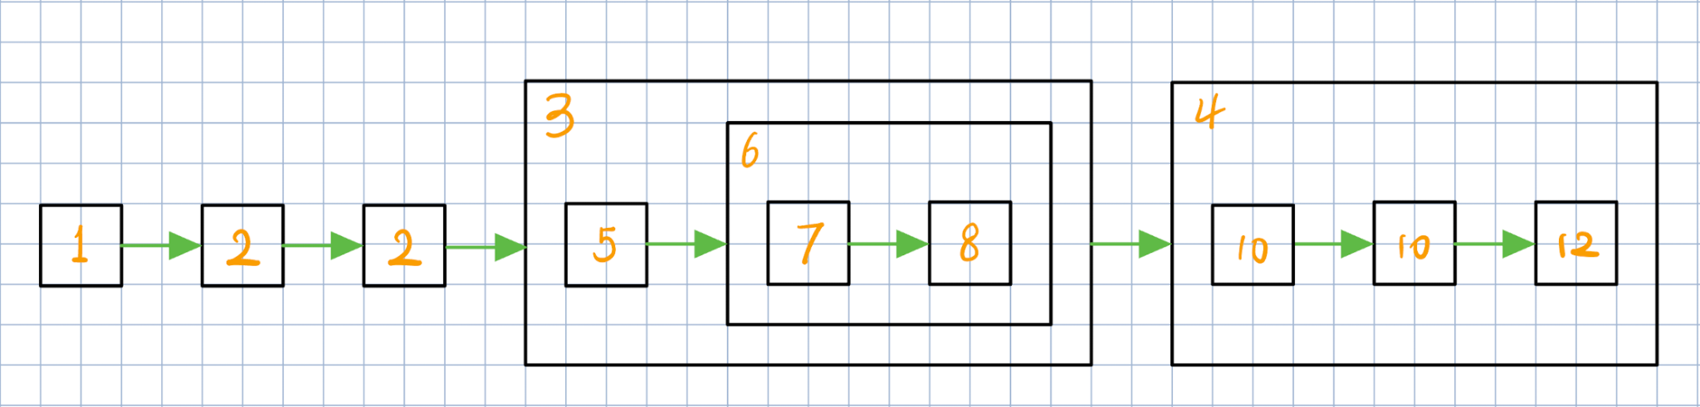
Analysis
For each node in the CFG, it may be executed thousand times in a loop, or the function it belongs is called thousand times,

Slide 7
User Study 1
What They Liked
Visualisation of the CFG
Useful runtime information
Suggested Improvements
Meaningful coloring of CFG Nodes
More defined scope of CFG

Slide 8
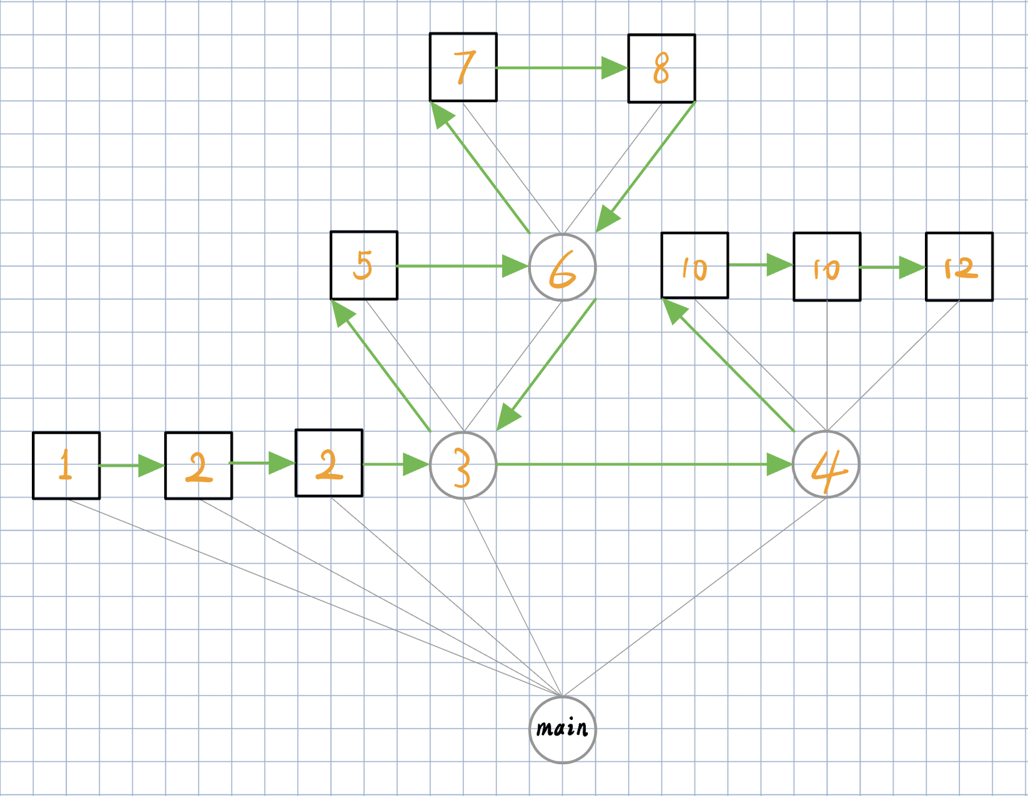
Execution Flow Graph (Tree)

Slide 9
User Study 2
What They Liked
Interface
Interaction with visualization
Suggested Improvements
Organization of CFG
Colored Nodes (again)

Slide 10
Evaluating Our Tool

Slide 11
Thank You !
Group 12 :
Pranipa, Mark, Syed, Has, Tengs

